Slide 1
OOPS LANGUAGE-OBJECT ORIENTED PROGRAMING LANGUAGE
C++

Slide 2
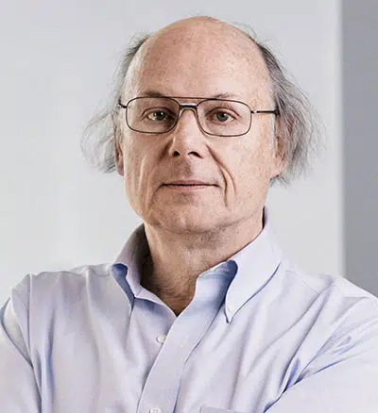
History Of C++
BJARNE STROUSTRUP
STARTED IN 1978 TO 1979
AT & T’S BELL LABORATORIES
C WITH CLASSES.
1983 FROM THEN KNOW AS C++

Slide 3
COMPARISION BETWEEN C AND C++
C++ IS SUPER SET OF C LANGAUGE
C ++ PROGRAMS CAN USE EXISTING C SOFTWARE LIBRARIES
C FOLLOWS TOP DOWN APPROCH OF PROGRAMING
C++ FOLLOWS BOTTOM UP APPROCH OF PROGRAMING
C ADOPTS PROCEDURE ORIENTED PROGRAMING
C ++ ADOPTS OBJECT ORIENT PROGRAMING

Slide 4
OBJECT ORIENTED PROGRAMING
OOPS is programing approach which revolves around the concept of “Object” .
Any entity in the system that can be define as set of properties and set of operations performed using entity’s property set, is know as Object.
Entity means example.
Ex. There is school then object is Rahul, Ramesh, Gita and Sita.

Slide 5
OBJECT ORIENTED PROGRAMING
ENCAPSULATION
DATA HIDING
ABSTACTION
POLYMORPHISM
INHERITANCE

Slide 6
THANK YOU

